Slide 1
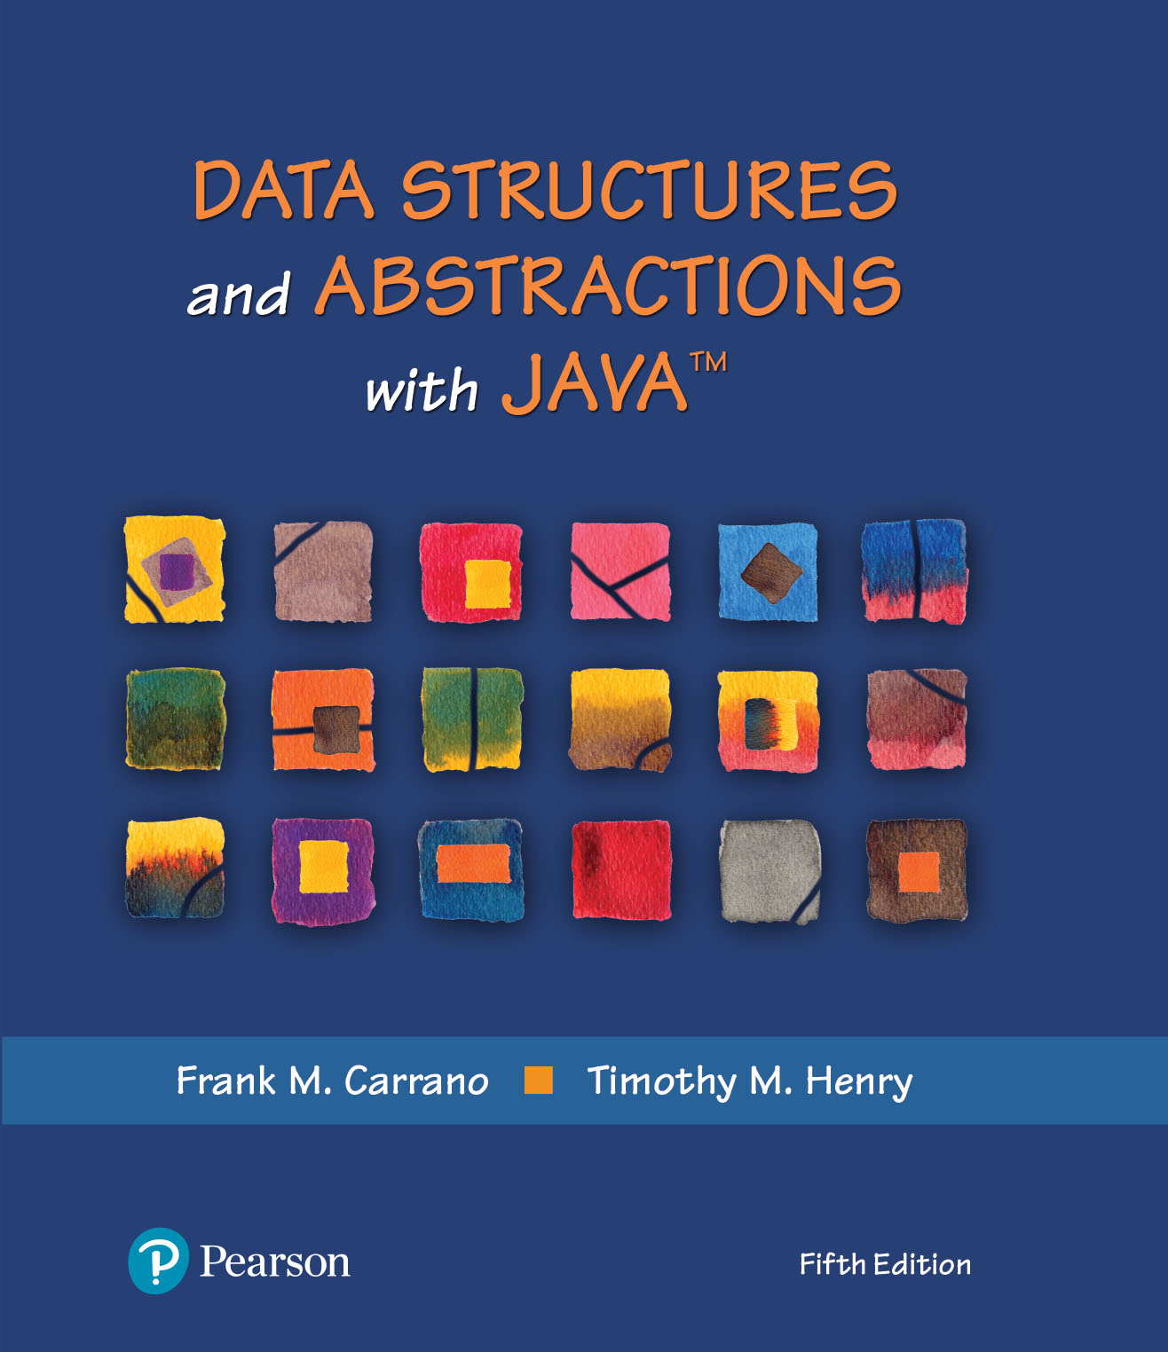
Module 16 – Sets & Maps

Slide 2
Additional Resources
Java Set | Video
https://www.youtube.com/watch?v=rruCajMgvGA
Set Operations in Java
https://www.baeldung.com/java-set-operations
File Input & Output, Supplement 2 (PDF, Course Content)
Basic I/O
https://docs.oracle.com/javase/tutorial/essential/io/index.html
How to Read and Write Binary Files in Java
https://www.codejava.net/java-se/file-io/how-to-read-and-write-binary-files-in-java

Slide 3
Set
Unordered collection of distinct elements
Unordered; no duplicates
Operations
Adding an element
Adding an element has no effect if the element is already in the set
Removing an element
Attempting to remove an element that isn’t in the set is silently ignored
Containment testing
Does the set contain a given object?
Listing all elements (in arbitrary order)
Notes:
What do we mean by unordered?
Dictionary(K, V)

Slide 4
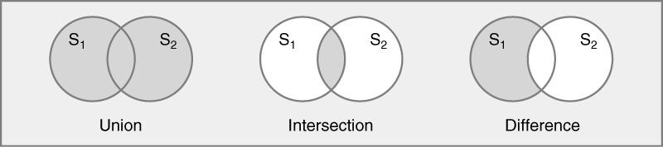
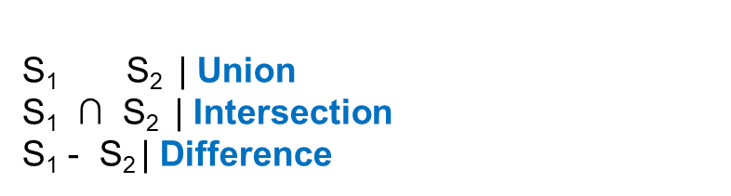
Basic Set Operations
Notes:
What’s a set?
https://www.codejava.net/java-core/collections/java-set-collection-tutorial-and-examples

Slide 5
Explicit vs. Implicit Implementations
Bit Vector | Explicit
Each item in the base type has a representation in each instance of a set
The representation is either true (item is in the set) or false
Space is proportional to the cardinality of the base type
All bit vectors use same amount of memory regardless of number of elements
Algorithms use Boolean operations

Slide 6
Bit Vector | Array-Based Implementation
Bit vector:
If setA has the following elements:
(A, D, K, M, P, R, T, V, X, Z)
setA
A | B | C | D | E | F | G | H | I | J | K | L | M | N | O | P | Q | R | S | T | U | V | W | X | Y | Z
1 | 0 | 0 | 1 | 0 | 0 | 0 | 0 | 0 | 0 | 1 | 0 | 1 | 0 | 0 | 1 | 0 | 1 | 0 | 1 | 0 | 1 | 0 | 1 | 0 | 1
If setB has the following elements:
(A, C, E, G, I, L, M, O, Q, T, U, W, Z)
setB
A | B | C | D | E | F | G | H | I | J | K | L | M | N | O | P | Q | R | S | T | U | V | W | X | Y | Z
1 | 0 | 1 | 0 | 1 | 0 | 1 | 0 | 1 | 0 | 0 | 1 | 1 | 0 | 1 | 0 | 1 | 0 | 0 | 1 | 1 | 0 | 1 | 0 | 0 | 1
* of course would not work with infinite base types or large base types

Slide 7
Union (Or Operation)
setA
A | B | C | D | E | F | G | H | I | J | K | L | M | N | O | P | Q | R | S | T | U | V | W | X | Y | Z
1 | 0 | 0 | 1 | 0 | 0 | 0 | 0 | 0 | 0 | 1 | 0 | 1 | 0 | 0 | 1 | 0 | 1 | 0 | 1 | 0 | 1 | 0 | 1 | 0 | 1
setB
A | B | C | D | E | F | G | H | I | J | K | L | M | N | O | P | Q | R | S | T | U | V | W | X | Y | Z
1 | 0 | 1 | 0 | 1 | 0 | 1 | 0 | 1 | 0 | 0 | 1 | 1 | 0 | 1 | 0 | 1 | 0 | 0 | 1 | 1 | 0 | 1 | 0 | 0 | 1
Union
setA U setB
resultvector
A | B | C | D | E | F | G | H | I | J | K | L | M | N | O | P | Q | R | S | T | U | V | W | X | Y | Z
1 | 0 | 1 | 1 | 1 | 0 | 1 | 0 | 1 | 0 | 1 | 1 | 1 | 0 | 1 | 1 | 1 | 1 | 0 | 1 | 1 | 1 | 1 | 1 | 0 | 1
Notes:
Or operation

Slide 8
Intersection (And Operation)
setA
A | B | C | D | E | F | G | H | I | J | K | L | M | N | O | P | Q | R | S | T | U | V | W | X | Y | Z
1 | 0 | 0 | 1 | 0 | 0 | 0 | 0 | 0 | 0 | 1 | 0 | 1 | 0 | 0 | 1 | 0 | 1 | 0 | 1 | 0 | 1 | 0 | 1 | 0 | 1
setB
A | B | C | D | E | F | G | H | I | J | K | L | M | N | O | P | Q | R | S | T | U | V | W | X | Y | Z
1 | 0 | 1 | 0 | 1 | 0 | 1 | 0 | 1 | 0 | 0 | 1 | 1 | 0 | 1 | 0 | 1 | 0 | 0 | 1 | 1 | 0 | 1 | 0 | 0 | 1
Intersection
A | B | C | D | E | F | G | H | I | J | K | L | M | N | O | P | Q | R | S | T | U | V | W | X | Y | Z
1 | 0 | 0 | 0 | 0 | 0 | 0 | 0 | 0 | 0 | 0 | 0 | 1 | 0 | 0 | 0 | 0 | 0 | 0 | 1 | 0 | 0 | 0 | 0 | 0 | 1
setA setB
resultvector
U

Slide 9
Difference (A – B Operation)
A | B | C | D | E | F | G | H | I | J | K | L | M | N | O | P | Q | R | S | T | U | V | W | X | Y | Z
1 | 0 | 0 | 1 | 0 | 0 | 0 | 0 | 0 | 0 | 1 | 0 | 1 | 0 | 0 | 1 | 0 | 1 | 0 | 1 | 0 | 1 | 0 | 1 | 0 | 1
setA
A | B | C | D | E | F | G | H | I | J | K | L | M | N | O | P | Q | R | S | T | U | V | W | X | Y | Z
1 | 0 | 1 | 0 | 1 | 0 | 1 | 0 | 1 | 0 | 0 | 1 | 1 | 0 | 1 | 0 | 1 | 0 | 0 | 1 | 1 | 0 | 1 | 0 | 0 | 1
setB
Difference
setA - setB
resultvector
A | B | C | D | E | F | G | H | I | J | K | L | M | N | O | P | Q | R | S | T | U | V | W | X | Y | Z
0 | 0 | 0 | 1 | 0 | 0 | 0 | 0 | 0 | 0 | 1 | 0 | 0 | 0 | 0 | 1 | 0 | 1 | 0 | 0 | 0 | 1 | 0 | 1 | 0 | 0

Slide 10
Implicit Implementations
Items in an instance of a set are on a list that represents the set
Items that are not on the list are not in the set
Space is proportional to the cardinality of the
set instance
Small sets use less memory than large sets
Algorithms use List operations

Slide 11
Implicit Implementation
If setB has the following elements:
(A, C, E, G, I, L, M, O, Q, T, U, W, Z)
If setA has the following elements:
(A, D, G, K, M, P, R, T, V, X, Z)
A
C
E
G
I
L
M
O
Q
T
U
W
Z
setA
setB
A
D
G
K
M
P
R
V
X
Z
What’s setA U setB (Union)?

Slide 12
Union (setA U setB)
setB
result.items
A
C
D
E
G
I
K
L
M
P
Q
R
T
U
W
X
Z
curposRes
A
C
E
G
I
L
M
O
Q
T
U
W
Z
curposB
setA
curposRes
curposB
curposRes
A
D
G
K
M
P
R
V
X
Z
curposB
curposA
curposB
curposRes
curposA
curposA
curposB
curposRes
curposA
curposA
curposB
curposRes
curposA
curposA
curposRes
curposB

Slide 13
Intersection (setA setB)
U
Intersection
setA setB
U
setA.items
setB.items
result.items
A
D
G
K
M
P
R
T
V
X
Z
A
C
E
G
I
L
M
O
Q
T
U
W
Z
A
G
M
T
Z

Slide 14
Difference (setA – setB)
setA.items
setB.items
result.items
A
C
E
G
I
L
M
O
Q
T
U
W
Z
D
K
P
R
V
X
A
D
G
K
M
P
R
T
V
X
Z

Slide 15
Sets | Big O (Time Complexity)
Implicit Explicit
add O(n) O(1)
remove O(n) O(1)
union O(n²) unorderd O(n)
O(n) ordered
intersection O(n²) unordered O(n)
O(n) ordered
difference O(n²) unordered O(n)
O(n) ordered
isEmpty O(1) O(n)
contains O(n) O(1)
subset O(n²) O(n)

Slide 16
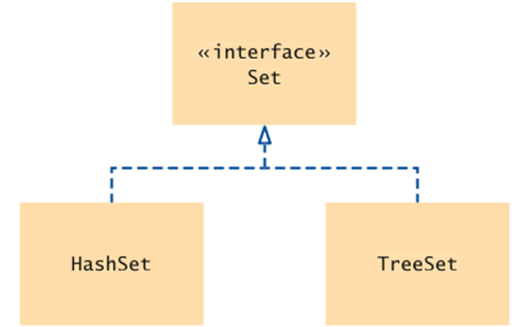
Set Classes | Java Standard Library
As a rule of thumb, use a hash set unless you want to visit the set elements in sorted order
https://docs.oracle.com/javase/8/docs/api/java/util/Set.html

Slide 17
Set | Bulk Operations
Bulk operations are well suited to Sets; they perform standard set-algebraic operations:
s1.addAll(s2) — transforms s1 into the union of s1 and s2
s1.retainAll(s2) — transforms s1 into the intersection of s1 and s2
s1.removeAll(s2) — transforms s1 into the (asymmetric) set difference of s1 and s2
s1.containsAll(s2) — returns true if s2 is a subset of s1
s2 is a subset of s1 if set s1 contains all of the elements in s2

Slide 18
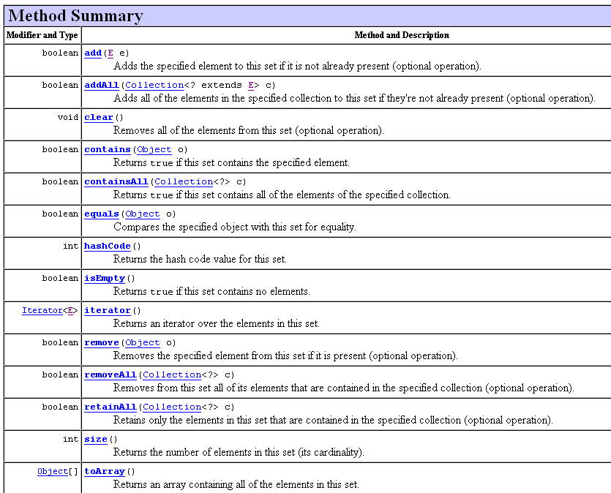

Slide 19
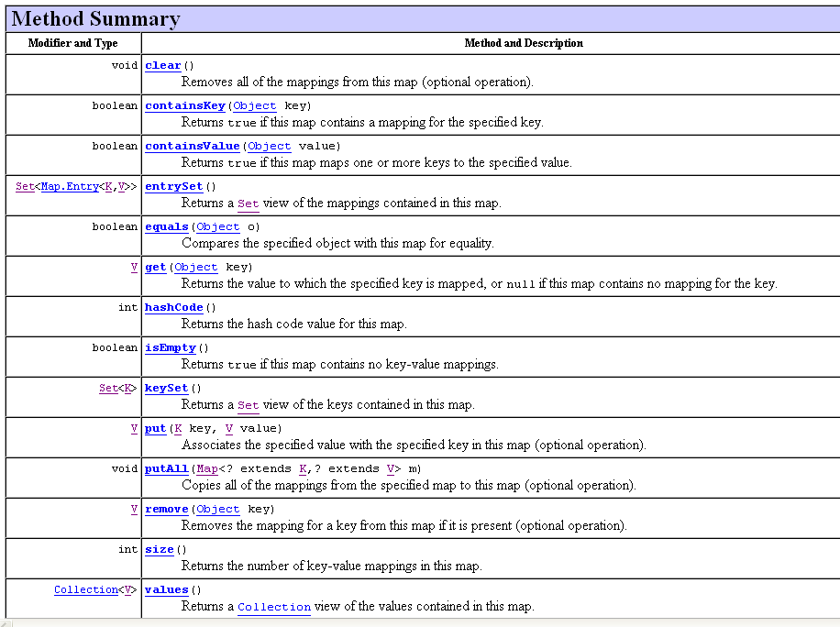

Slide 20
Set Example (1 of 2)
To calculate the union, intersection, or set difference of two sets nondestructively
Copy one set before calling the appropriate bulk operation
The following are the resulting idioms
Set<Type> union = new HashSet<Type>(s1);
union.addAll(s2);
Set<Type> intersection = new HashSet<Type>(s1); intersection.retainAll(s2);
Set<Type> difference = new HashSet<Type>(s1);
difference.removeAll(s2);

Slide 21
Set Example (2 of 2)
List of Names
Construct the Set:
Set<String> names = new HashSet<>();or
Set<String> names = new TreeSet<>();
Add and remove elements:
names.add("Romeo");
names.remove("Juliet");
Test whether an element is contained in the set:
if (names.contains("Juliet")) . . .

Slide 22
Activity: Spell Checker
Read in all words from a dictionary ﬁle that contains correctly spelled words and place them into a set
Read all words from a document into a second set — here, the book “Alice in Wonderland”
Print all words from that set that are not in the dictionary set — potential misspellings

Slide 23
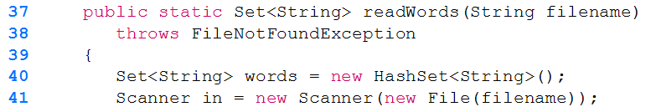
Question?
Suppose you changed a SpellCheck program from using a TreeSet instead of a HashSet. How would the output change?
Notes:
Words would be listed in sorted order, based on the natural ordering for the objects, in this case Strings

Slide 24
Set vs. Array vs. List
Pros vs. Cons
Why would you want to use a set instead of an array or list?
Efficient set implementations can quickly test whether a given element is a member of the set
Can do unions, intersections and differences
Notes:
Arrays and lists remember the order in which you added elements; sets do not

Slide 25
Iterator
Use an iterator to visit all elements in a set
A set iterator does not visit the elements in the order in which they were inserted
An element cannot be added to a set at an iterator position
A set element can be removed at an iterator position

Slide 26
Visiting Elements | Iterator
Iterator<String> iter = names.iterator(); while (iter.hasNext()) { String name = iter.next(); Do something with name }
or, using the “for each” loop:
for (String name : names) { Do something with name }

Slide 27
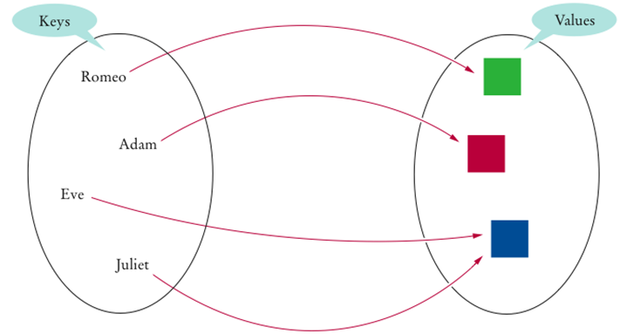
Map

Slide 28
Map
A map keeps associations between key and value objects
Mathematically speaking, a map is a function from one set, the key set, to another set, the value set
Every key in a map has a unique value
A value may be associated with several keys
Classes that implement the Map interface
HashMap
TreeMap
Both data structures implement the Map interface
Use a hash map unless you want to visit the set elements in sorted order

Slide 29
Set vs. Map
What is the difference between a set and a map?
A set stores unique elements. A map stores associations between keys and values
Why is the collection of the keys of a map a set?
The ordering does not matter, and you cannot have duplicates

Slide 30
Hash Map
In a hash map, only the keys are hashed
The keys need compatible hashCode and equals method
If we used Strings as the key, hashcode and equals are already defined
Duplicate Keys
https://www.baeldung.com/java-map-duplicate-keys

